Slide 1
INSTRUCTIONS
REMOVE THIS SLIDE
This file contains slides for presenting NFDI4Earth to a general academic audience – our “target group“. You can pick a one, two, five, or 10 slide version.
The single slide is for pitching NFDI4Earth and its services, for example, when having the opportunity to advertise a booth to a conference audience. Remove all other slides to use it. To use only two slides, remove this slide, the pitch slide, and all slides after the first “Thank you“ slide. To use five slides, also remove the second “Thank you“ slide and everything after it. To use 10 slides, only remove this slide, the pitch slide, and the two intermediary “Thank you” slides.
Contact the coordination office with questions and feedback: nfdi4earth-coordination@tu-dresden.de.
Notes:
INSTRUCTION SLIDE – please remove before presentation

Slide 2



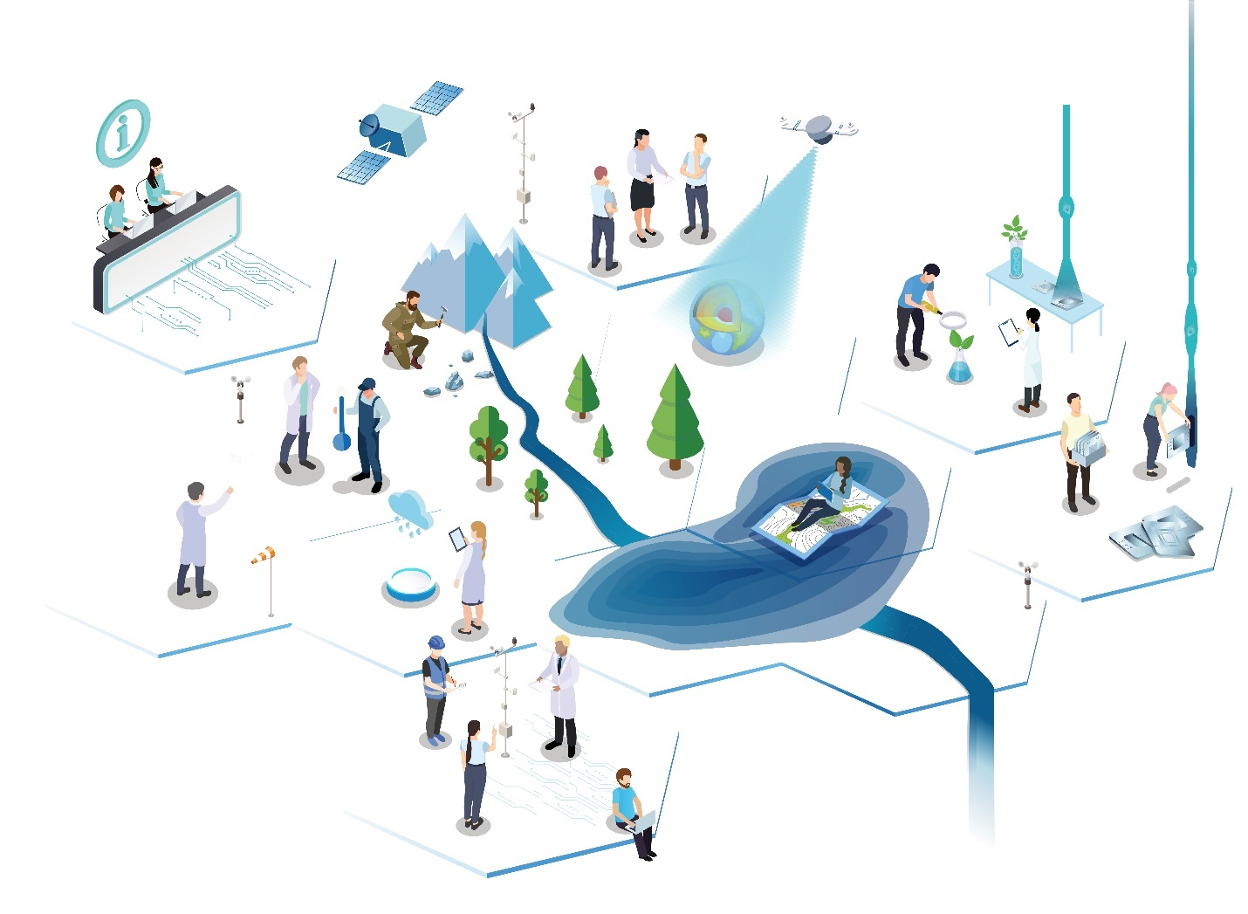







NFDI Consortium Earth System Sciences
NFDI4Earth is one consortium & community for Open and FAIR Research Data Management in ESS in Germany across research, academia, public administration, and key infrastructures and as an active driver of the NFDI.
This work has been funded by the German Research Foundation (DFG) through the project NFDI4Earth (DFG project no. 460036893, https://nfdi4earth.de/) within the German National Research Data Infrastructure (NFDI, https://www.nfdi.de/).
Notes:
PITCH SLIDE

Slide 3
NFDI4Earth
NFDI Consortium Earth System Sciences
nfdi4earth.de

Slide 4







NFDI4Earth
One consortium & community for Open and FAIR Research Data Management in ESS in Germany across research, academia, public administration, and key infrastructures and as an active driver of NFDI.
30
Letters of Interest ≈
35+ Mio
Funding
70+ signed commitment
89
Public events
(co-)organized
120+
open reports/ presentations
20+
ESS RDM
Courses
500+
OERs accessible
Leading
This work has been funded by the German Research Foundation (DFG) through the project NFDI4Earth (DFG project no. 460036893, https://nfdi4earth.de/) within the German National Research Data Infrastructure (NFDI, https://www.nfdi.de/).
50+
Pilots and incubators
for FAIR RDM in Earth System Sciences
850k+
Datasets
160+ repositories
discoverable
Helpdesk Cluster with 10 Consortia

Slide 5
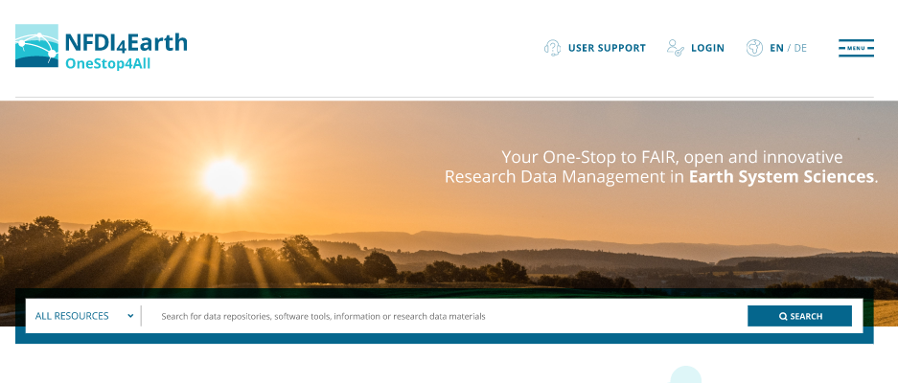
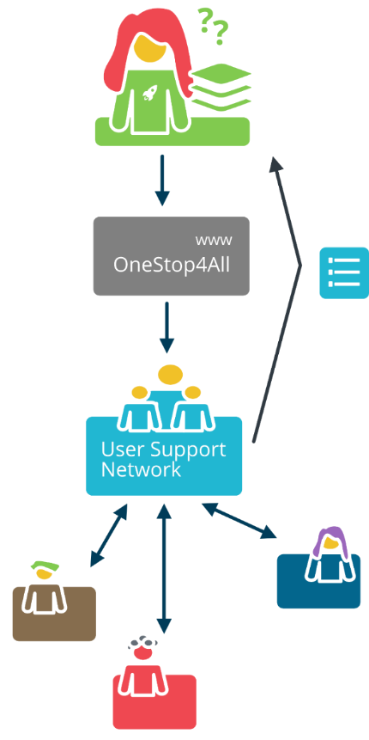
Core Services developed by the Consortium
OneStop4All offers unified exploring all NFDI4Earth resources.
Knowledge Hub is the information backbone offers metadata for broad range of resources including datasets, learning resources, repositories, organizations, standards, and research software.
User Support Network offers first and second level-support to researchers on RDM, linking and enhancing existing, federated support structures.
EduTrain Portal offers open courses for ESS-RDM micro-curricula; tested in the NFDI4Earth Academy.
Notes:
Our core services hereby build the technological backbone of our service portfolio. While the NFDI4Earth KnowlegdeHub aggregates metadata for a broad range of resources, the UserSupportNetwork is set-up to guide users asefficiently as possible towards the specific help they are asking for. For broadening the general understanding of how toprofessionally manage and make use of research data in Earth system sciences, our EduTrainPortal offers a phlethora ofresources of varying level of detail. All services together are linked to the OneStop4All as a single-point-of-entry for our NFDI4Earth service portfolio.

Slide 7
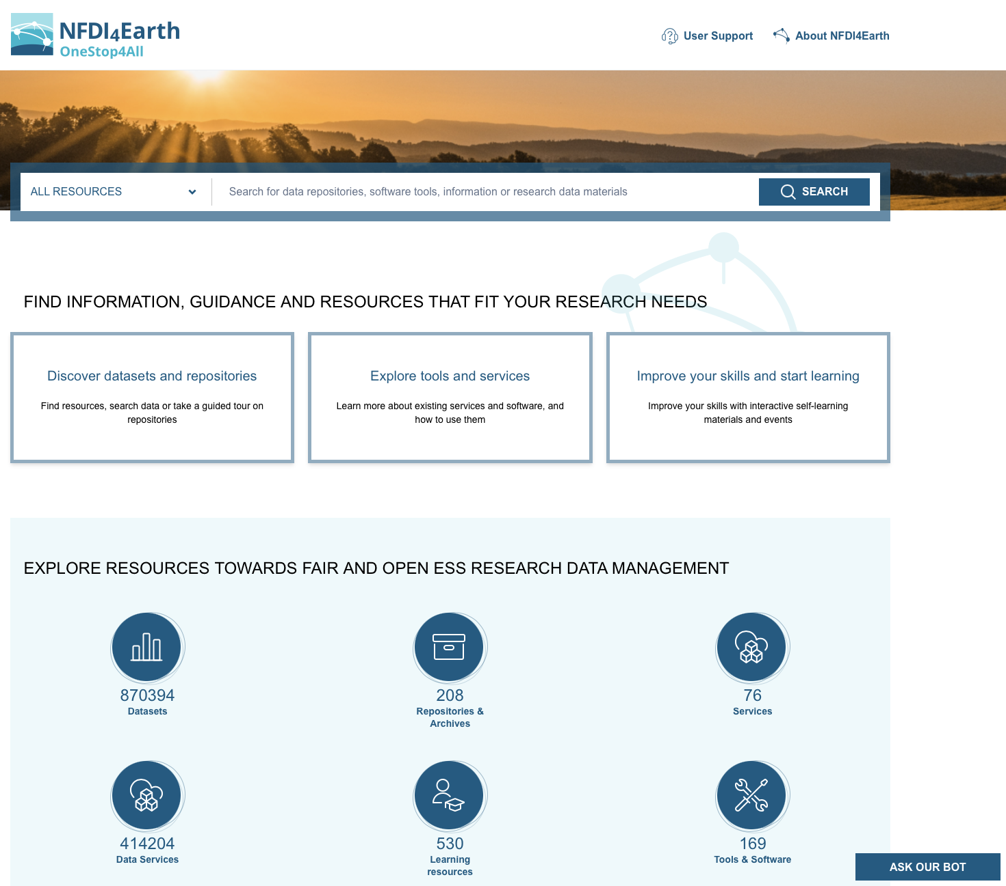
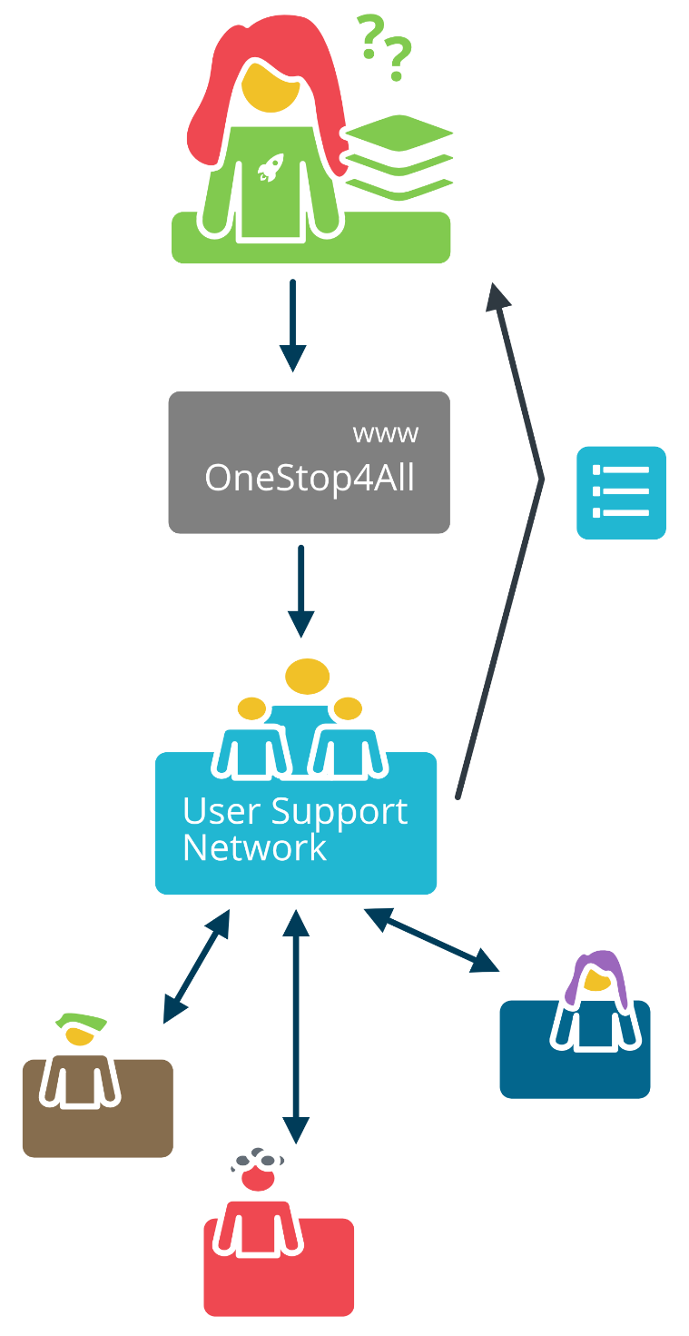
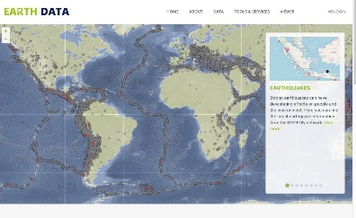











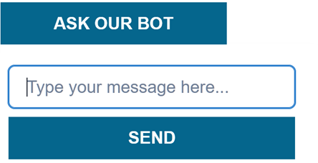
Core Services connect NFDI4Earth Service Portfolio
Notes:
However, the service portfolio itself comprises more than just the core services being mentioned. There is a large community of Earth system scientists worldwide providing a rich set of services with more and more offers emergingcontinuously. At the same time, there is an increasing need to be able to access high-level computing and other IT services. With focusing on the one Earth, we must build on these offerings, combining them into a comprehensive portfolio ofhigh-quality services, which our user community can rely on also in a somewhat more distant future. This is why ourgeneral approach is open for others to contribute, while at the same time working to assure sufficient quality of such contributions. For the coming phase, we aim to closer integrate our service portfolio into the emerging network of NFDI as well as the European open science cloud.

Slide 8
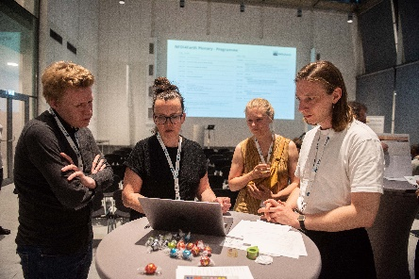
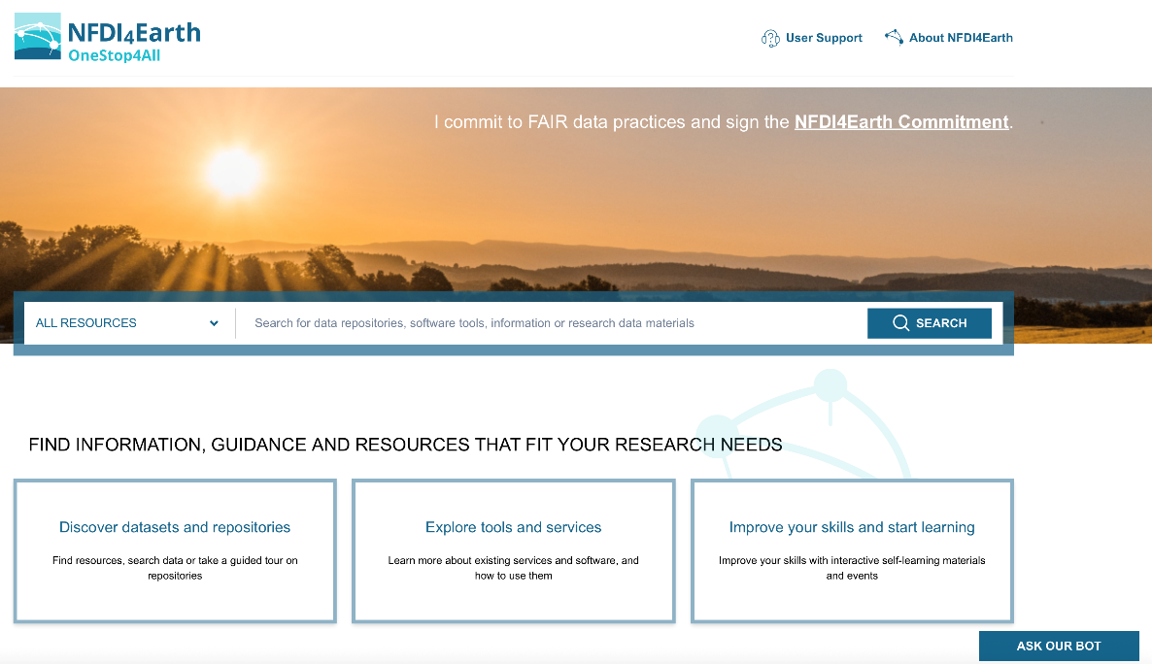
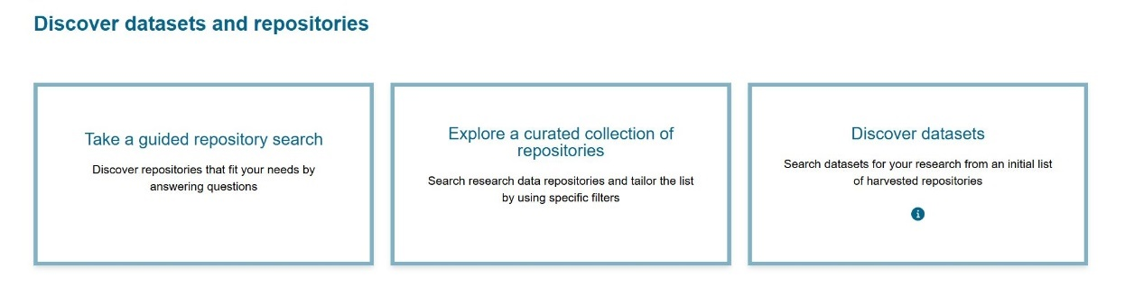
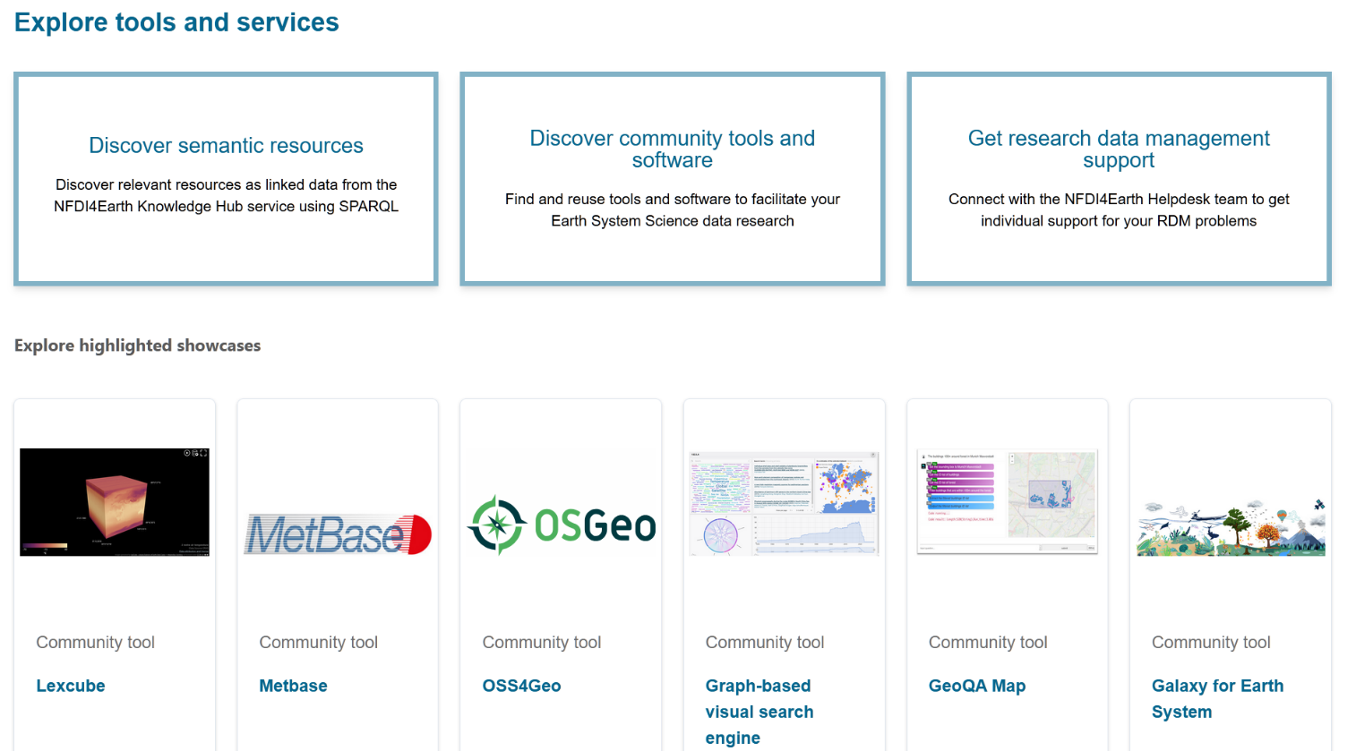

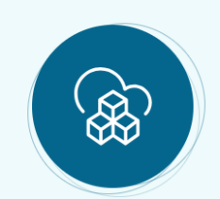



OneStop4All
Community Portal developed in a user-centered design process with the Earth System Sciences community
Entry point to community resources and NFDI4Earth-developed services
Guided tours and curated information
800k+
Datasets
150+
Repositories
400k+
(Data) Services
500+
Learning Resources
150+
Tools & Software
140+
Handbook Articles
90+
Standards
https://onestop4all.nfdi4earth.de/

Slide 9


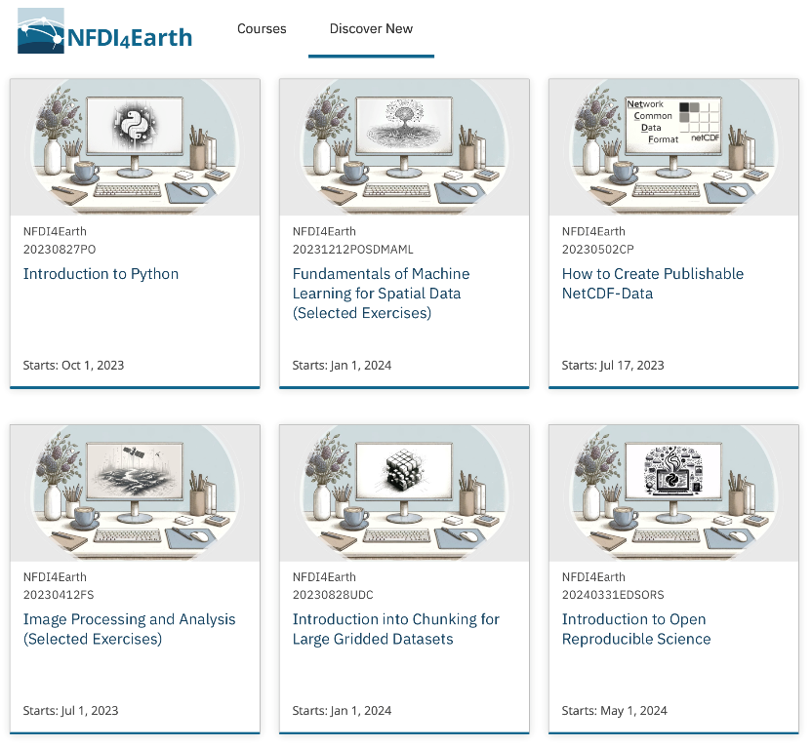
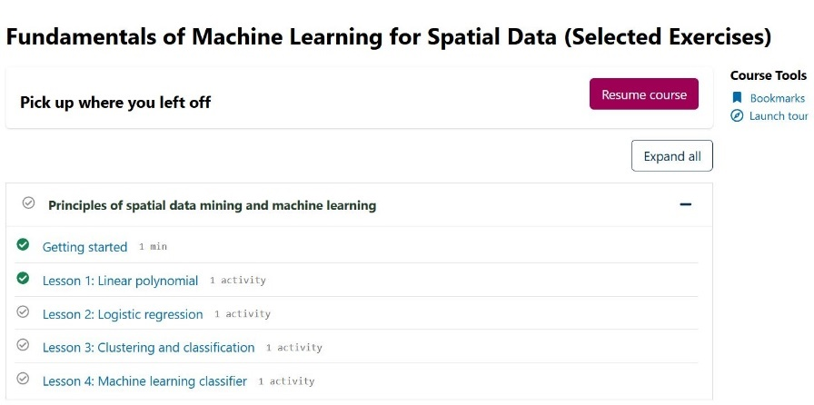
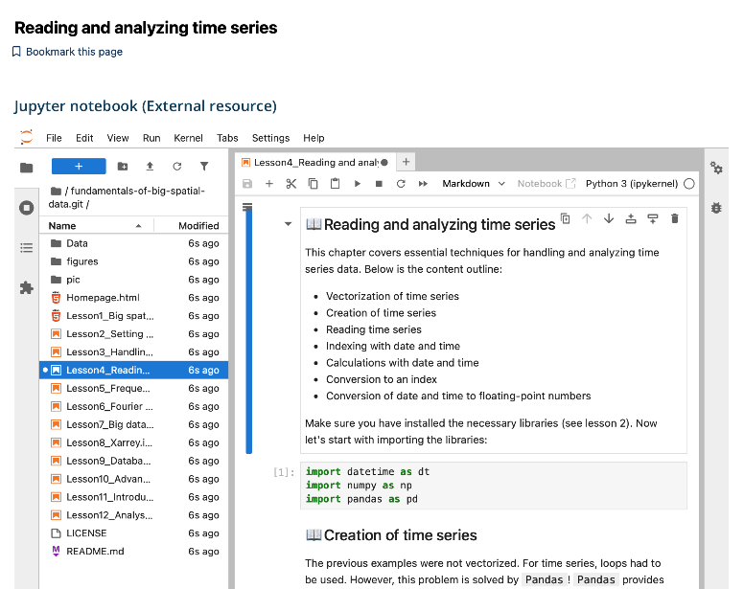
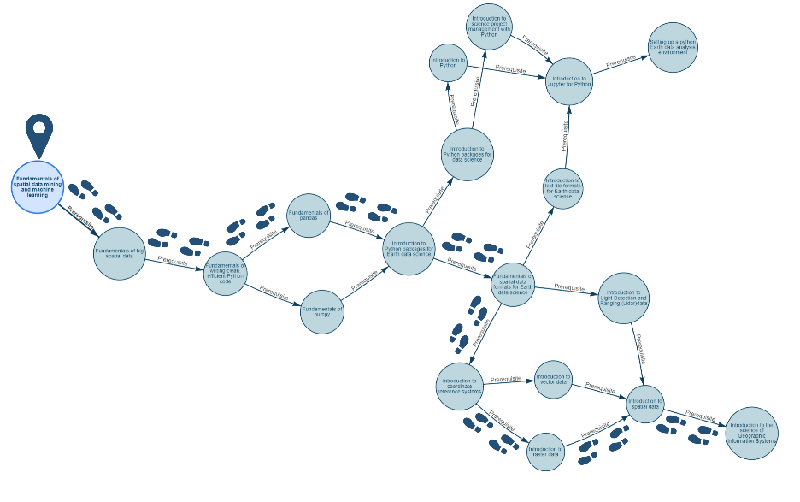
Education & Training
73
Academy fellows in
2 cohorts
56
Educatio-nal events
held
20+
NFDI4Earth-developed courses (incl. 270+ modules)
250+
Active EduTrain portal users
60+
Training and how-to videos
500+
Harvested
OER materials
EduTrain Portal
Common Learning Management System for Open Educational Resources (OER)
Offers curated interactive self-learning courses (notebooks, videos, exercises, …)
Development of personalised learning paths
Building on top of Base4NFDI services
https://edutrain.nfdi4earth.de/
Notes:
The EduTrain portal is learning management system where students can take a course at their own pace. The interactive courses offered there are also available on NFDI’s GitLab, so that the individual parts of a course – individual sections, notebooks, or even single images – can be reused for other training formats in NFDI4Earth and beyond.
All materials are provided with metadata, and we have already made the first steps to combine modules from our platform into personalised learning paths. Each person comes with very specific pervious knowledge, and we will soon be able to apply language models to recommend modules and exercises that fit a person’s pervious knowledge, learning goals and the application area. This way, we also support lifelong learning and enable experienced researchers to learn additional new skills.
On the technology side, the portal does not reinvent the wheel. We use the open-source platform OpenEdX as a basis and build on Base4NFDI services where possible, such as for authentication and soon for the deployment of interactive notebooks.

Slide 11
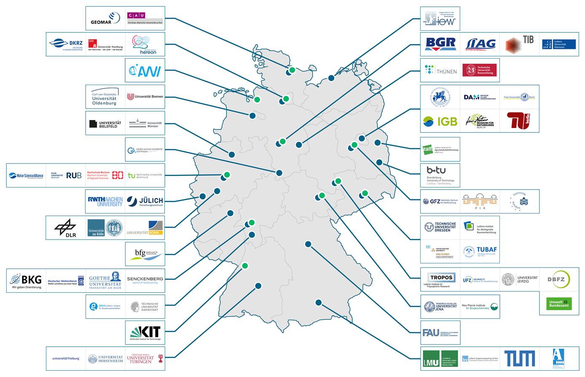

The NFDI4Earth Consortium in 2026
65+ partners cover the breadth of German Earth System Sciences
Integrates key users, infrastructure providers, and public administration
Is a key driver within the NFDI
Established an international network with a European Focus
30
Letters of Interest ≈
35+ Mio
Funding
70+ signed commitment
89
Public events
(co-)organized
120+
open reports/ presentations
20+
ESS RDM
Courses
500+
OERs accessible
Leading
50+
Pilots and incubators
for FAIR RDM in Earth System Sciences
850k+
Datasets
160+ repositories
discoverable
Helpdesk Cluster with 10 Consortia
Notes:
Today we can say, that we have succeeded in bringing together the breadth of Earth System Sciences in Germany in NFDI4Earth, making us one of the largest NFDI consortia.
Half of our consortium consists of universities, which play a key role in multiplying our impact. With our numerous exchange formats and cooperation agreements with ongoing research projects, we have succeeded in reaching our community – especially those close to research. The prominent reference to NFDI4Earth in the Leopoldina report on Earth System Sciences is proof that we have achieved visibility and acceptance in our national research system.
We also integrate government partners such as the the German Weather Service – as public data is a key asset for our research.
We benefit greatly from the integration of relevant providers of high-performance computing and data infrastructures.
This enabled us to make an important contribution to the establishment of the NFDI. The fact that we were asked to take the lead in Base4NFDI can serve as one performance indicator here.
We have established an extensive international network. As discussed during the midterm review, we focused Europe in the first funding phase - but did already also reach beyond Europe.

Slide 12

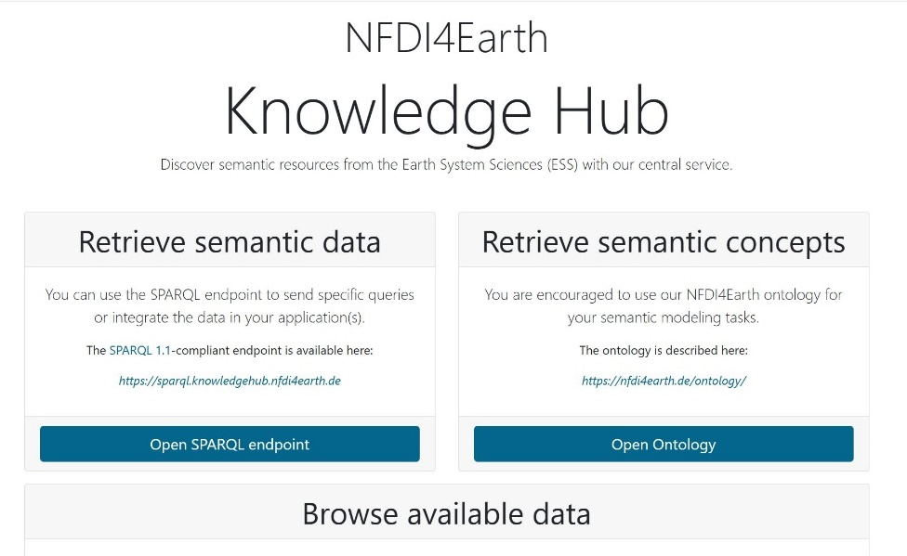







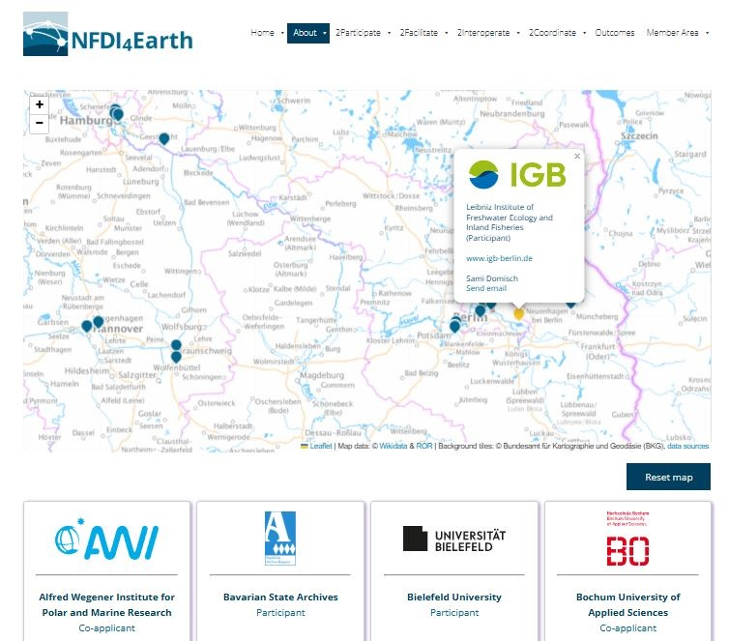
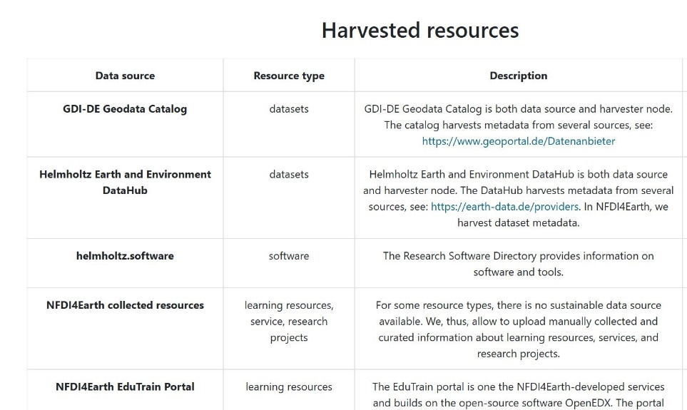
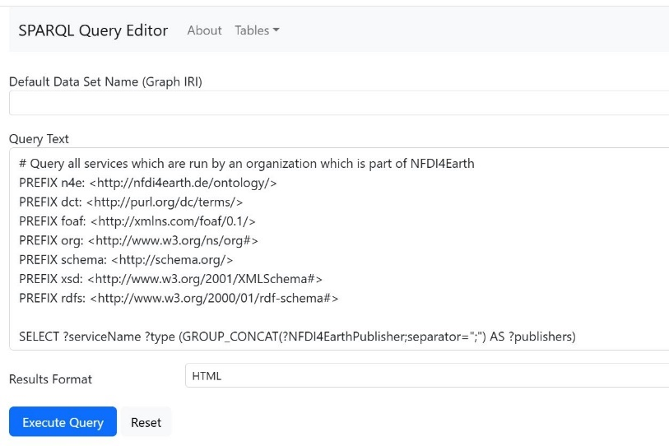
NFDI4Earth Knowledge Hub
Linked data service for RDM ESS resources
Provides a SPARQL API for software development
Backbone service, e.g., for OneStop4All
Offers a semantic-enabled endpoint for harvested data sources to the providers
Notes:
Offers a semantic-enabled endpoint for harvested data sources to the providers
-> Data Source Provider können Schnittstelle mit semantic-enabled data über unseren Knowledge Hub anbieten

Slide 13
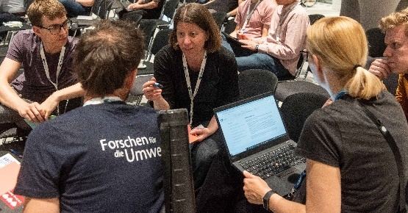

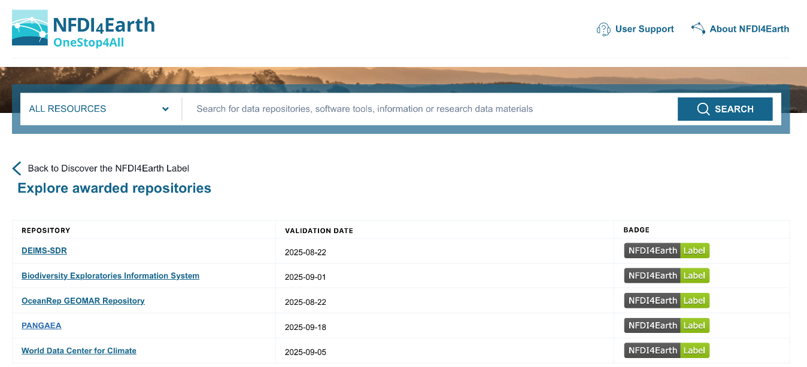
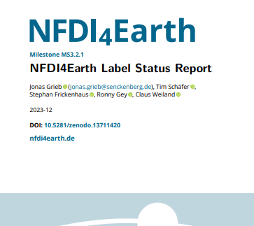
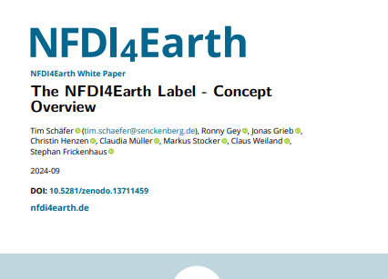
NFDI4Earth Label for Data Repositories
Developed criteria in a participative process with Earth System Science community
Defined evaluation process:
automated assessment: re3data metadata, F-UJI evaluation
manual self-assessment
Implemented as OneStop4All extension using NFDI IAM Basic Service
Collaborate tightly with re3data (MoU signed) to facilitate providers in managing their records
Initiated discussion on NFDI-wide labeling
Notes:
-> several online & onsite workshops with providers, users and other stakeholders

Slide 14











NFDI4Earth Commitment for Organisations & Individuals
Commit to FAIR data practices and sign the NFDI4Earth FAIRness and Openness Commitment: https://nfdi4earth.de/commitment
We commit to advance FAIRness and Openness
in Earth System Sciences.
We value data infrastructures and data experts.
2 main statements | 12 supplemental statements 8 institutional signatories | 70 groups & individuals
Sign the statement of commitment as institutions, individual researchers, laboratories, infrastructure providers, publishers, academic societies, government agencies, companies, funders, and research organisations. Become ambassadors for change towards more FAIR and Open data practices in Earth System Sciences. Respond to the growing geo-societal challenges of our planet: science advances when knowledge is openly shared.
YES WE CHANGE

Slide 15
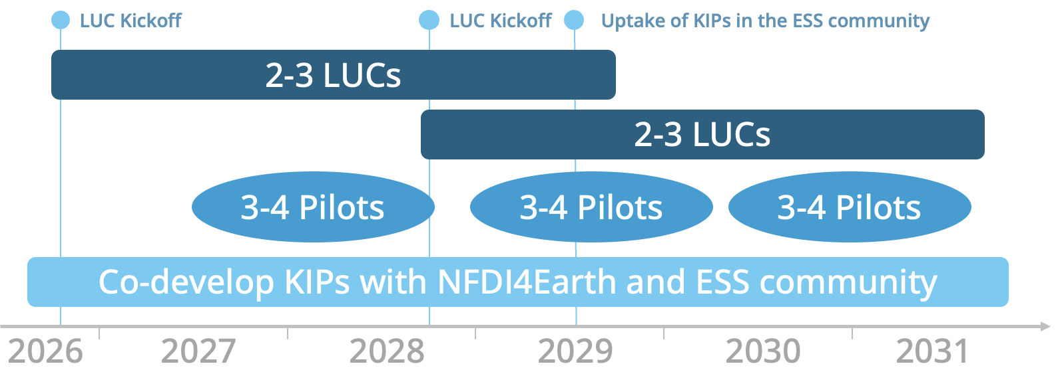
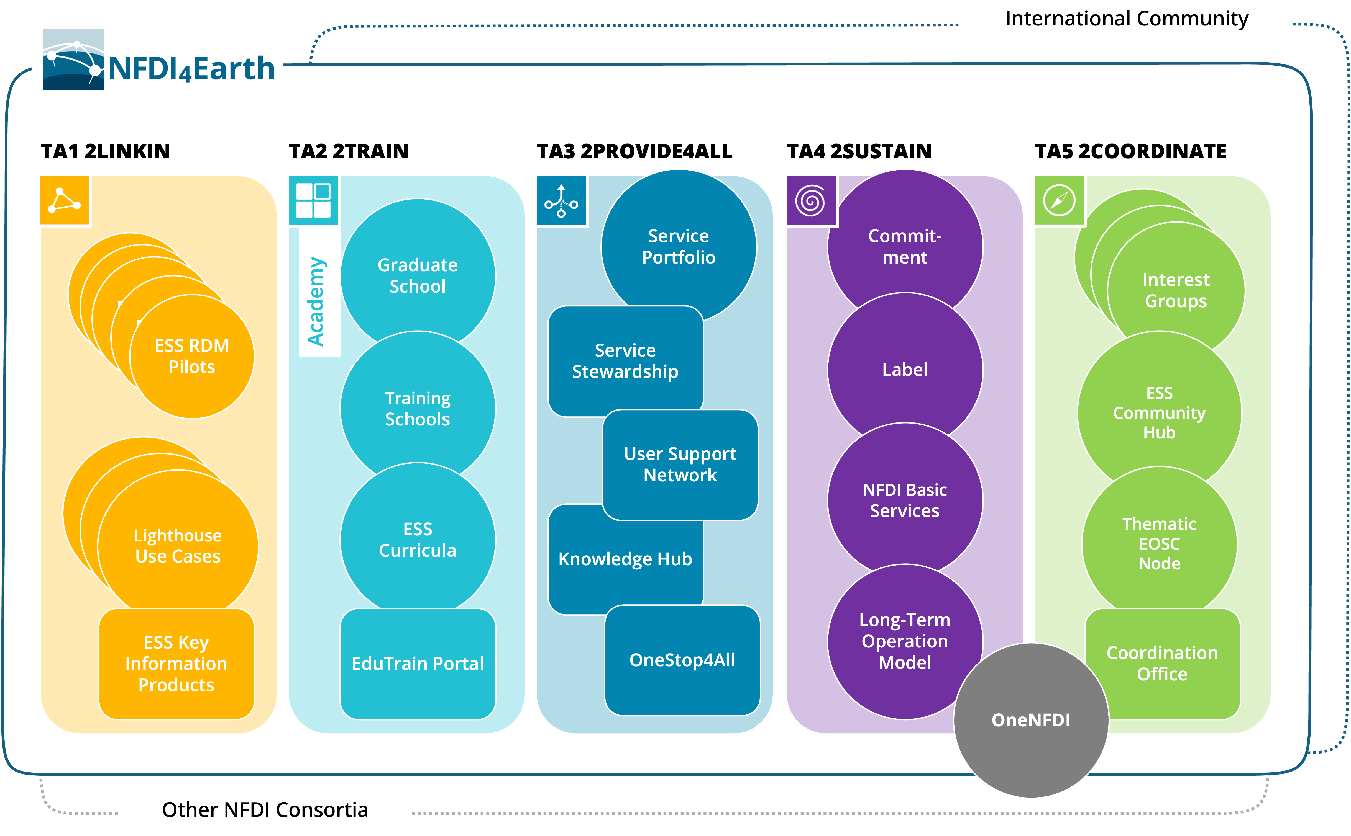
















NFDI4Earth 2026+
Proposal submitted in 2025, decision planned for summer 2026
Light House Use Cases (LUCs)
Key Information Products (KIPs) structure research data for interdisciplinary use
Activating and engaging the community (e.g., Pilots, Academy & School, EduTrain portal)
Service portfolio management
Connecting with: NFDI, ERICs, EOSC, ...

